Slide 1
Maps in the Brain and their models

Slide 2
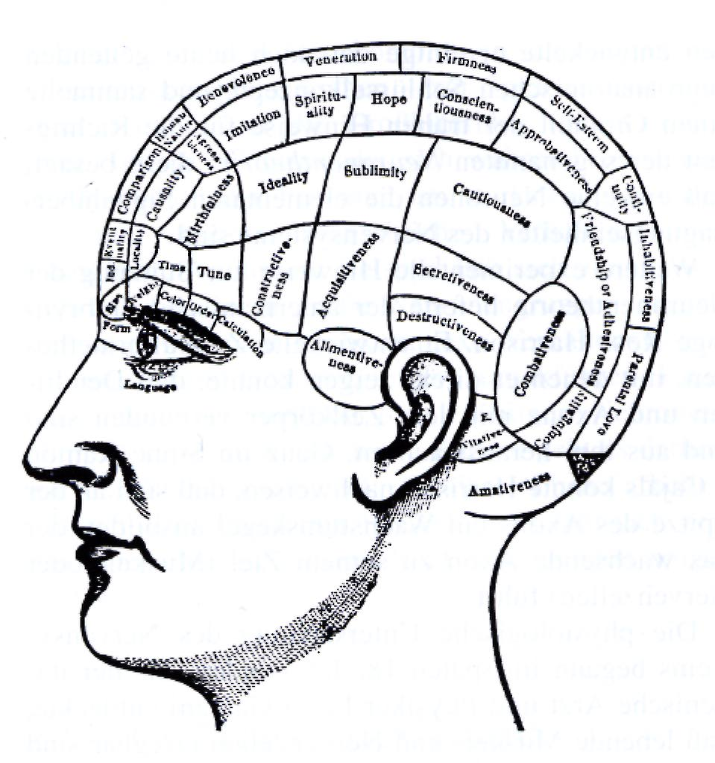
Where are things happening in the brain.
Is the information
represented locally ?
The Phrenologists view
at the brain
(18th-19th centrury)
CNS
Systems
Areas
Local Nets
Neurons
Synapses
Molekules

Slide 3
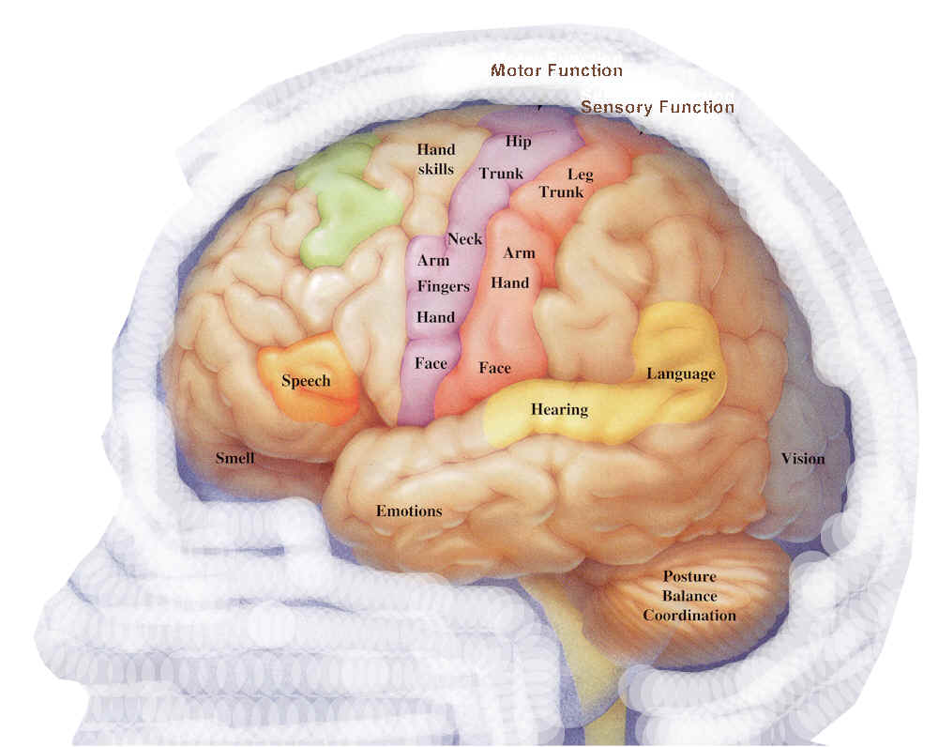
Maps in the Brain and their models

Slide 4
Overview
A few words about Maps
Cortical Maps: Development and (Re-)Structuring
Place fields
Visual maps
Auditory maps

Slide 5

What are Maps I
Intuitive Definition: Maps are a (scaled) depiction of a certain area.
Location (x,y) is directly mapped to a piece of paper. Additional
information such as topographical, geographical, political can be
added as colors or symbols.

Slide 6
What are Maps I
Intuitive Definition: Maps are a (scaled) depiction of a certain area.
Location (x,y) is directly mapped to a piece of paper. Additional
information such as topographic, geographic, political can be
added as colors or symbols.
Important: A map is always
a reduction in complexity.
It is a REDUCED picture
of reality that contains
IMPORTANT aspects of it.
What is important? That is
in the eye of the beholder...

Slide 7

What are Maps II
Mathematical Definition: Let W be a set, U a subset of W and A
metric space (distances are defined). Then we call f a map if it is
a one-to-one mapping from U to A.
f: U -> A
Example: The surface of the world (W) is a 2D structure embedded
in 3D space. It can be mapped to a 2D
euclidean space.
In a mathematical sense a map is an
equivalent representation of a complex
structure (W) in a metric space (A),
i.e. it is not a reduction – the entire
information is preserved.

Slide 8
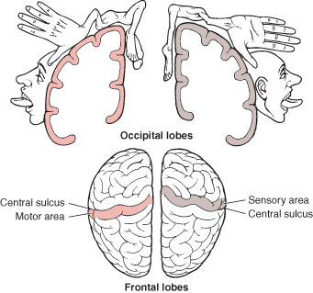

Cortical Maps
Cortical Maps map the environment onto the brain. This includes
sensory input as well as motor and mental activity.
Example: Map of sensory and motor representations of the body
(homunculus).The more important
a region, the bigger its
map representation.
Scaled “remapping” to real space

Slide 9

Place Cells
Spatial Maps

Slide 10
What are place cells?
Place cells are the principal neurons found in a special area of the mammal brain, the hippocampus.
They fire strongly when an animal (a rat) is in a specific location of an environment.
Place cells were first described in 1971 by O'Keefe and Dostrovsky during experiments with rats.
View sensitive cells have been found in monkeys (Araujo et al, 2001) and humans (Ekstrom et al, 2003) that may be related to the place cells of rats.

Slide 11
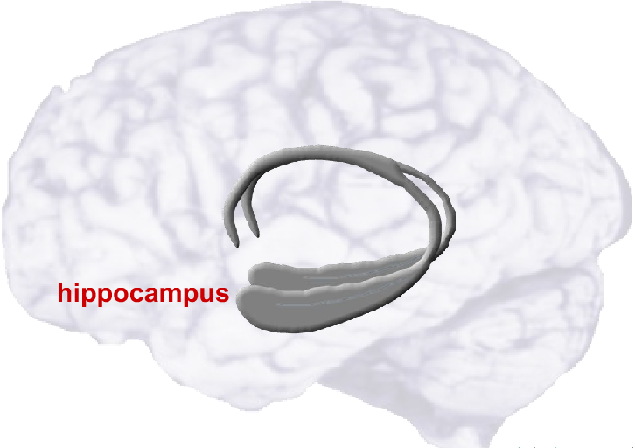
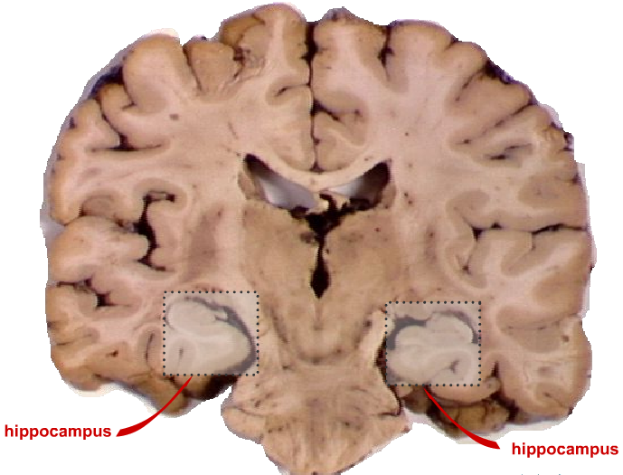
The Hippocampus
Human
hippocampus

Slide 12
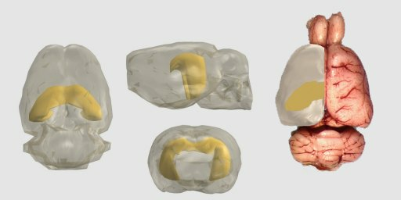
The Hippocampus
Human
hippocampus
Rat
hippocampus

Slide 13
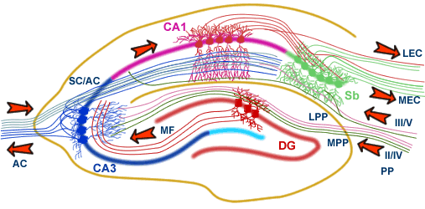
Hippocampus
Place cells
Visual
Olfactory
Auditory
Taste
Somatosensory
Self-motion
Hippocampus involved in learning and memory
All sensory input into hippocampus
Place cells in hippocampus get all sensory information
Information processing via trisynaptic loop
How place cells are exactly used for navigation is unknown

Slide 14
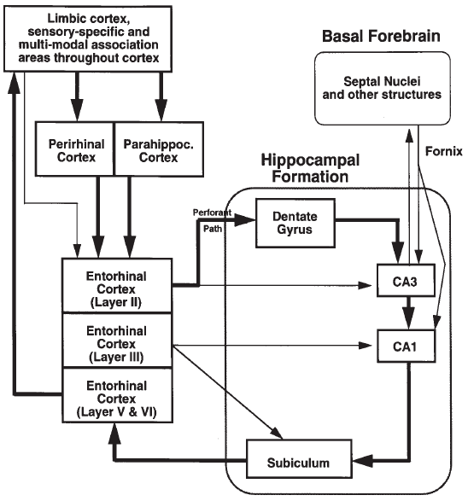
Myers et al., 1996

Slide 15
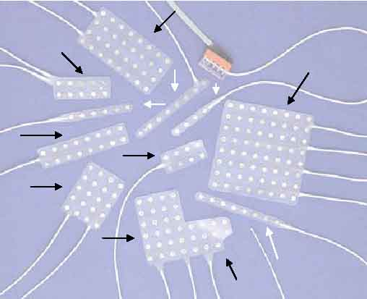
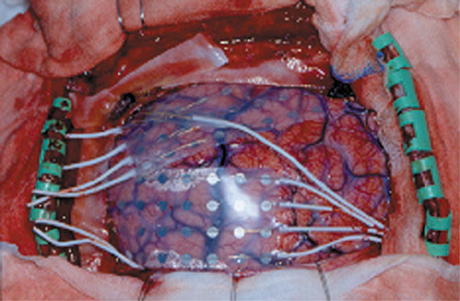
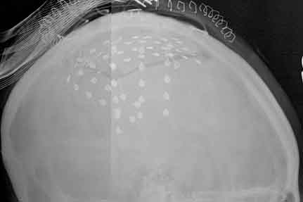
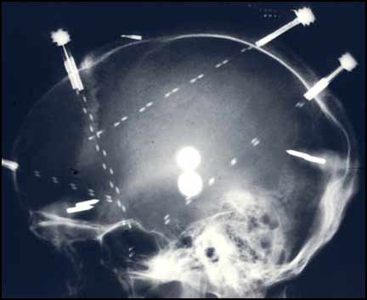
Recordings from humans
Ekstrom et al,
2003

Slide 16
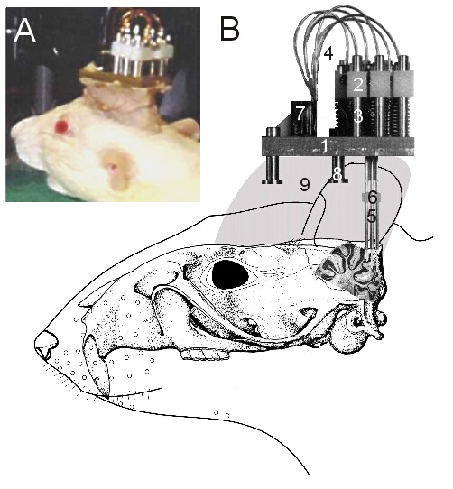
Place cell recordings
1.
Electrode array is inserted to the brain for simultaneous recording of several neurons.
Wilson and McNaughton, 1993

Slide 17
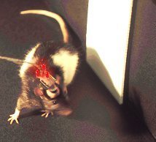
Place cell recordings
1.
2.
Electrode array is inserted to the brain for simultaneous recording of several neurons.
The rat moves around in a known/unknown environment.
Wilson and McNaughton, 1993

Slide 18
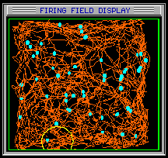
Place cell recordings
1.
2.
3.
Electrode array is inserted to the brain for simultaneous recording of several neurons.
The rat moves around in a known/unknown environment.
Walking path and firing activity (cyan dots).
Wilson and McNaughton, 1993

Slide 19


Place Field Recordings
Terrain: 40x40cm
Single cell firing activity
y
y
x
x
Map firing activity to position within terrain
Place cell is only firing around a certain position (red area)‏
Cell is like a “Position Detector”

Slide 20
Place fields
40x40cm
Array of cells
Ordered for position of activity peak (top left to bottom right)‏
O’Keefe, 1999

Slide 21
Place fields
40x40cm
Array of cells
Ordered for position of activity peak (top left to bottom right)‏
Different shapes:
Circular Islands
O’Keefe, 1999

Slide 22
Place fields
40x40cm
Array of cells
Ordered for position of activity peak (top left to bottom right)‏
Different shapes:
Circular Islands
Twin Peaks
O’Keefe, 1999

Slide 23
Place fields
40x40cm
Array of cells
Ordered for position of activity peak (top left to bottom right)‏
Different shapes:
Circular Islands
Twin Peaks
Elongated
O’Keefe, 1999

Slide 24
Place fields
40x40cm
Array of cells
Ordered for position of activity peak (top left to bottom right)‏
Different shapes:
Circular Islands
Twin Peaks
Elongated
O’Keefe, 1999

Slide 25
Grid cells
Grid cells, fire strongly when an animal is in specific locations in an environment, but have multi-peak firing fields which are organized into a hexagonal grid (entorhinal cortex).
Hafting et al, 2005; Sargolini et al, 2006

Slide 26
How do place cells develop?
Allothetic (external) sensory input
Visual
Olfactory
Somatosensory (via whiskers)‏
Auditory
Idiothetic (internal) sensory input
Self motion (path integration, mostly used then allothetic information is not available)‏
Not so reliable by itself since no feedback

Slide 27
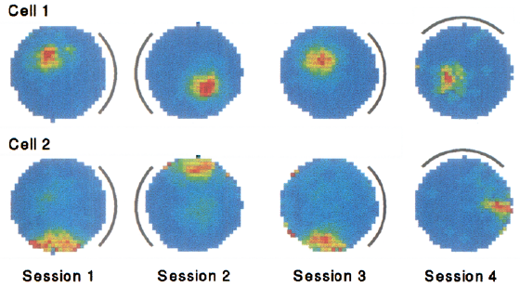
Importance of visual cues
Experiment: Environment with landmark (marked area) => record activity from cell 1 and 2
Observation: Place fields develop
Knierim, 1995

Slide 28
Importance of visual cues
Experiment: Environment with landmark (marked area) => record activity from cell 1 and 2
Observation: Place fields develop
Step 2: Rotate landmark => place fields rotate respectively
Conclusion: Visual cues are used for formation of place fields
Knierim, 1995

Slide 29
Vision is not necessary
Blind rats have similar place fields as sighted rats which suggests that space representation can be formed also from non-visual information such as somatosensory and olfactory.
Save et al, 1998

Slide 30
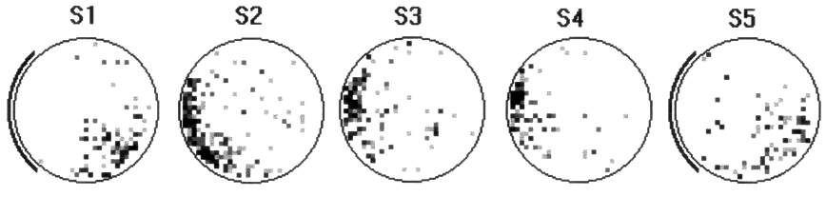
Importance of olfactory cues
Fact: Rats use their urine to mark environment
Experiment: Two sets, one in light and one in darkness; remove self-induced olfactory cues and landmarks (S2-S4)‏
Result: Without olfactory cues stable place fields (control S1) change or in darkness even deteriorate. When olfactory cues are allowed again (control S5), place fields reemerge.
Light/Cleaning
Dark/Cleaning
Save, 2000

Slide 31
Place Cell Remapping
Brown plastic square box and white wooden circle box was used to show place cell
remapping phenomena:
Cells 1-5 show increasing divergence between the square and circle box;
Cells 6-10 show differentiation from the beginning;
Some cells chow common representation or do not remap at all (not shown).
Wills et al, 2005, Science

Slide 32
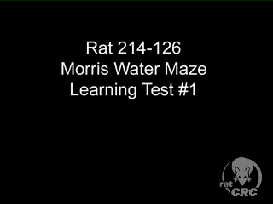
Morris water maze task

Slide 33
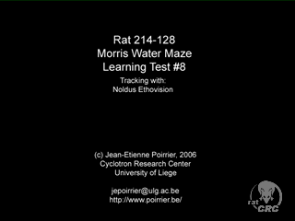
Morris water maze task

Slide 34
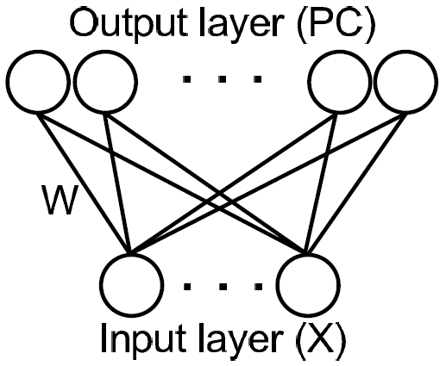
Place cell model
Use neuronal network to model formation of place cells
Input layer for allothetic sensory input depending on position in simulated world
4 Visual cues (landmarks)‏

Slide 35
Place cell model
Use neuronal network to model formation of place cells
Input layer for allothetic sensory input depending on position in simulated world
4 Visual cues (landmarks)‏
4 Olfactory cues (environmental)‏

Slide 36
Place cell model
Use neuronal network to model formation of place cells
Input layer for allothetic sensory input depending on position in simulated world
4 Visual cues (landmarks)‏
4 Olfactory cues (environmental)‏
Output layer, n x n simulated neurons, each of which is connected to all input neurons (fully connected feed-forward)‏

Slide 37
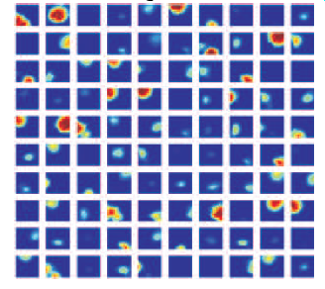
Place cell model
Use neuronal network to model formation of place cells
Input layer for allothetic sensory input depending on position in simulated world
4 Visual cues (landmarks)‏
4 Olfactory cues (environmental)‏
Output layer, nxn simulated neurons, each of which is connected to all input neurons (fully connected feed-forward)‏
After learning => formation of place fields

Slide 38
Place cell model
Use neuronal network to model formation of place cells
Input layer for allothetic sensory input depending on position in simulated world
4 Visual cues (landmarks)‏
4 Olfactory cues (environmental)‏
Output layer, nxn simulated neurons, each of which is connected to all input neurons (fully connected feed-forward)‏
After learning => formation of place fields
The know-how is in the change of the connection weights W ...

Slide 39
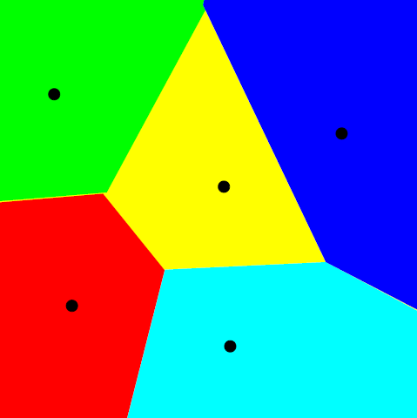
Vector quantization (VQ)
Signal approximation method that forms an approximation to the probability density function p(x) of stochastic variable x using a finite number of so-called codebook vectors (reference vectors) w_{i}, i=1, 2,…,k.
Finding closest reference vector w_{c}:
c = arg min_{i} {||x-w_{i}||},
where, ||x-w_{i}|| - Euclidian norm
Reference vector w_{i}
Voronoi set

Slide 40
VQ: Optimization
Average expected square of quantization error:
E = ||x-w_{c}||²p(x)dx
∫
For every x, with occurrance probability given via p(x), we calculate the error how good some w_{c} would approximate x and then integrate over all x to get the total error.
Gradient descent method:
dw_{i}
= α δ_{ci} (x-w_{i}), δ_{ci} – Kronecker delta (=1 for c=i, 0 otherwise)
dt
Gradient descent is used to find those w_{c} for which the error is minimal.

Slide 41
What Learning does
As d₁ is minimal
distance we shift
only the closest
codebook vector.
d₃
Repeat this for all x
d₂
x
d₁
Gradient descent method:
dw_{i}
= α δ_{ci} (x-w_{i}), δ_{ci} – Kronecker delta (=1 for c=i, 0 otherwise)
dt
Gradient descent is used to find those w_{c} for which the error is minimal.

Slide 42
Mathematics of the model
Firing rate r of Place Cell i at time t is modeled as Gaussian function: σ_{f} is width of the Gaussian function, X and W are vectors of length n, ||* || is the euclidean distance

Slide 43
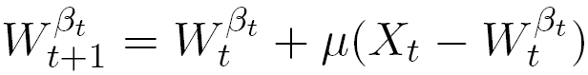
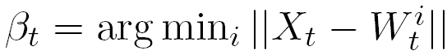
Mathematics of the model
Firing rate r of Place Cell i at time t is modeled as Gaussian function: σ_{f} is width of the Gaussian function, X and W are vectors of length n, ||* || is the euclidean distance
At every time step only one weight W is changed (Winner-Takes-All), i.e. the neuron with the strongest response is changed:

Slide 44
Place fields
Visual input => unique round place fields, because the distances to the walls are unique (no multipeaks)
Olfactory input => place fields not round, because input is complex (gradients not well structured)
Combined input is a mixture of both

Slide 45
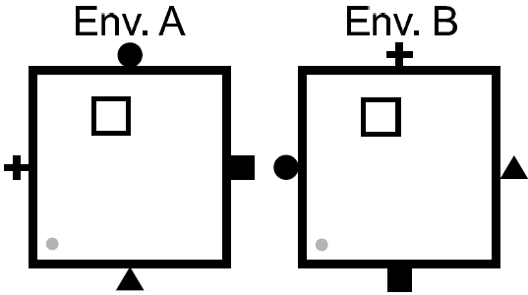
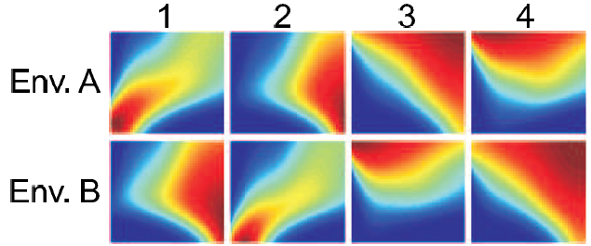
Place field remapping

Slide 47
Some extra info about rats

Slide 48
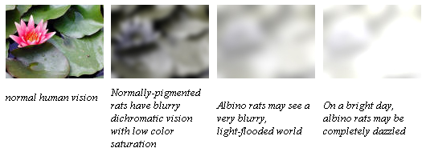
What do rats see?
Rat’s vision:
Dichromatic
Low saturation
Blurry
http://www.ratbehavior.org/

Slide 49
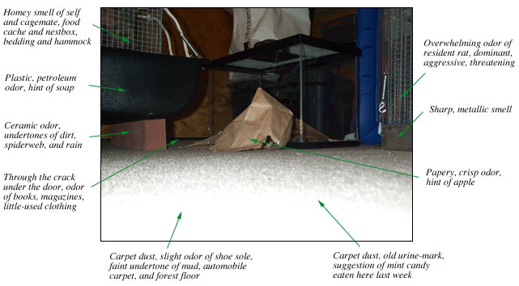
What do rats smell?
Incredibly, there are between 500 and 1,000 types of olfactory receptors, coded for by between 500 and 1,000 genes! That is about 1% of the rat's DNA (in humans ~400 receptors).

Slide 50
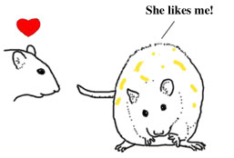
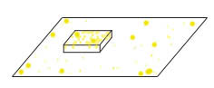

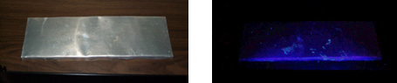
Why do rats mark?
Sexual advertisements
Maintain an odor field and help to navigate
Adult rats mark safe food sites

Slide 51

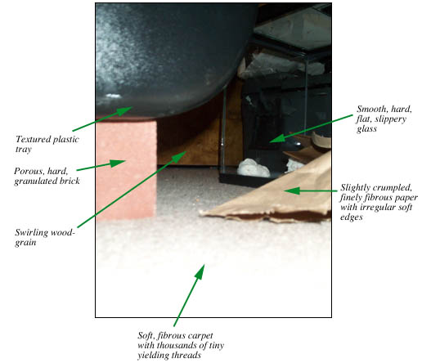
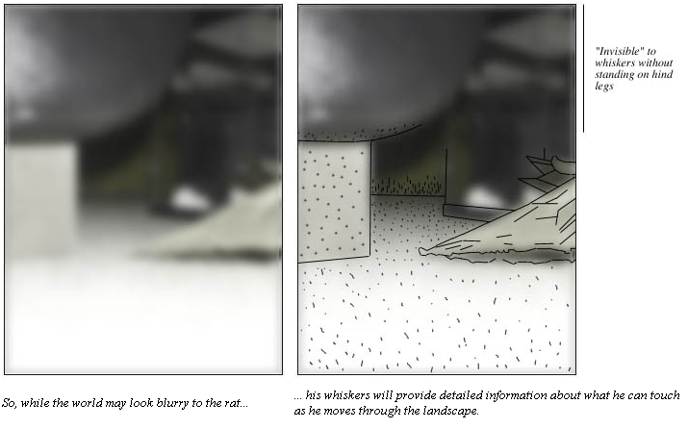
What do rats sense?
A rat perceives its immediate surroundings through its whiskers. It can navigate largely by touch.

Slide 52
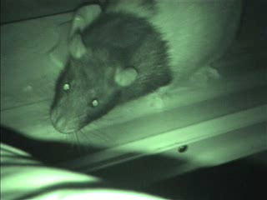
What do rats sense? Vibrissa Placement in the Dark

Slide 53
What do rats hear?
Rats hearing is much more sensitive than humans.
Rats can hear up to 90 kHz (humans up to 20 kHz ).
Rats communicate above our range of hearing (> 20 kHz).

